Slide 1
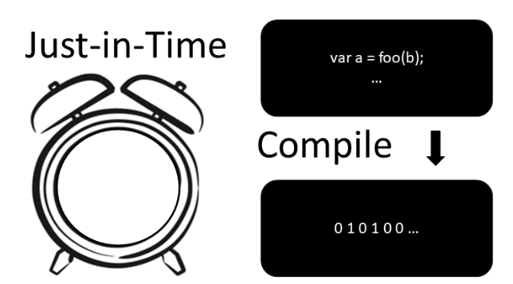
Workshop
Made by Jorge and Thijs

Slide 2
Table of contents
Student knowledge 15 min(Thijs)
What is compiler/interpreter?
How do they work?
What is JIT compiler? 5 min(Jorge)
What are the pros and cons of using jit compiler? 5 min(Jorge)
What are use cases for JIT compiler? 5 min(Jorge)
Exercises (GitHub) 30 min(Thijs en Jorge)
Future JIT? 2 min(Thijs)
Quizz /Reflection min(Jorge) 10 minuten
Questions 5 min(Thijs)

Slide 3
What is a compiler?
A compiler translates the entire source code of a program into machine code before execution.
The output is a standalone executable file that can be run independently.
Compilation is done once, and the executable can be reused multiple times without recompilation.
Compilers typically perform optimizations for better performance, resulting in faster execution.
Examples of compiled languages include C, C++, and Rust.

Slide 4
What is an interpreter?
An interpreter translates source code into machine code line-by-line during execution.
It does not produce an intermediate executable file; instead, it directly executes the code.
Each time the program runs, it must be interpreted anew, leading to slower execution compared to compiled code.
Interpreters are often used in development environments for easier debugging and testing.
Examples of interpreted languages include Python, JavaScript, and Ruby.

Slide 5
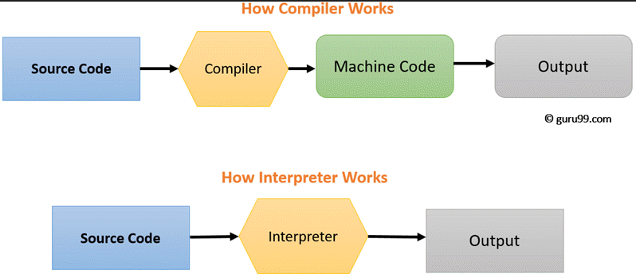
How does a compiler/interpreter work?

Slide 6
Compiled/interpreted - hybrid
Statically typed
C / C++ / Rust
Java, C# (Virtual Machine)
Dynamically typed
JavaScript
Engines like V8 (Node.js / Chrome / Edge)
Python (CPython (default) / PyPy), also Virtual Machine
Bash
Type blurring

Slide 7
What is just-in-time (JIT) compilation (also dynamic translation or run-time compilations)
John McCarthy in 1960.
method for improving the performance of interpreted programs.
dynamic compilation vs static compilation

Slide 8
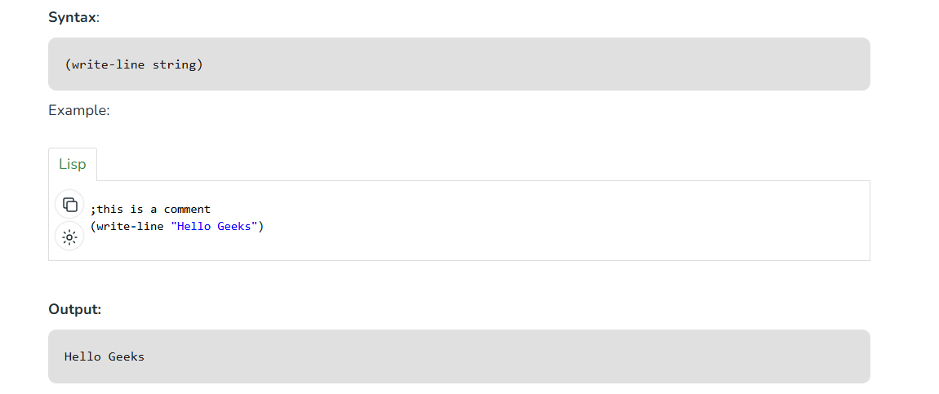
LISP programming language

Slide 9
What is JIT compiler?
John McCarthy in 1960.
method for improving the performance of interpreted programs.
dynamic compilation vs static compilation

Slide 10
What are the pros and cons of using jit compiler?
Advantages:
Adaptive optimizations based on actual usage.
Platform independence (for languages like Java and C#).
Faster execution after initial compilation.
Disadvantages:
Initial startup delay due to JIT compilation.
Memory overhead for both compiled and interpreted code.
Complexity in development and debugging.

Slide 11
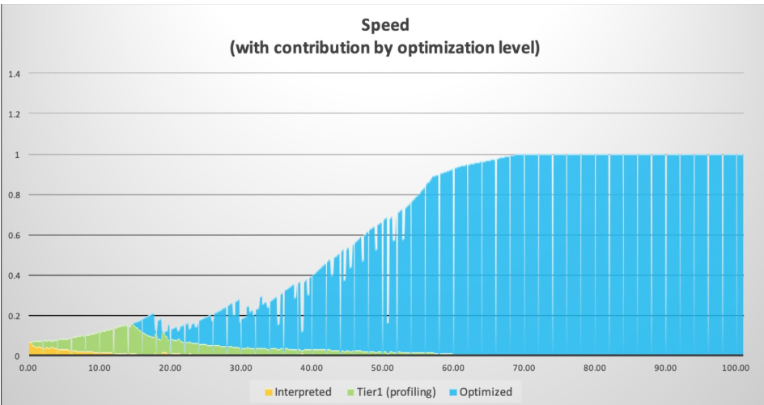
Warming-up JIT Compiler
Initial delay
More CPU usage
Memory overhead

Slide 12
What are use cases for JIT compiler?
Virtual machines
Dynamic languages(e.g. Javascript)
Gaming and graphics
Companies that work with big data

Slide 13
Where NOT to use JIT compiler
Programs with simplicity
Interpreters are easy to implement
Resource Constraints
Security Concerns
Examples are: C, C++, Rust, Go

Slide 14

Exercises
github.com/sebivenlo/
esd-2024-jit-compiler

Slide 15
What’s the future of JIT?
Dynamically vs statically typed
JIT compilation reduced the performance gap.
Statically typed languages will die?
No, the world (AI, high performance) need more speed and reliability.
9 oct 2024: Python (default) introduces JIT
ML/AI in JIT

Slide 16
Questions so far?

Slide 17
QUIZZ
Follow the steps to join the quizz game:
Go to link: https://quizizz.com/join
Insert the code provided at the workshop
Wait until everyone is ready to play
Have fun

Slide 18
Reflection
Did this workshop help you understand what JIT compilation can offer?
Is there a specific topic related to JIT compilation that you would like to learn more about or dive deeper into?
Did you enjoy the workshop?

Slide 19
Thank you for your attention.

